Slide 1
Tracy’s Artistic Effects
Notes:
Hi, in this video we’re going to learn more commands that will allow us to get more creative with our Tracy programs. Let’s jump in!

Slide 2



Tracy Command: color
color(“color_name”)
Changes the color of the trail Tracy leaves
color(“blue”)
forward(25)
color(“orange”)
forward(25)
Notes:
Tracy has been drawing lots of designs for us, but all of them have been black. We want to bring some color into Tracy’s world and with the color command, we can! Simply type the word ‘color’ and then a color name in quotation marks inside parentheses. Tracy and her trail will change to that color for all future commands.

Slide 3
What Color Names are Available?
Here are a few color names you can use:
black | orange
blue | pink
brown | purple
cyan | red
gold | white
gray | violet
green | indigo
Notes:
There are many colors that we can use. This list of acceptable colors can be referenced through the documents tab in our code editor, so you don’t have to memorize them.

Slide 4
What Color Names are Available?
To get a sense of how many color names are available, here are a few shades of blue you can call:
blue | midnight blue | turquoise
light blue | sky blue | cyan
medium blue | royal blue | teal
dark blue | cornflower blue | aqua
If you try to call a color that doesn’t exist, Tracy will default the color to black.
Notes:
But there are many, many more colors past the short list found in the documents tab. For example, all 12 of these versions of the color blue can be called with the color command. Try any color you wish to see if Tracy knows it. If not, she will not give you an error. She will just default back to black.

Slide 5


Tracy Command: pensize
pensize(number)
Changes the thickness of the trail Tracy leaves
pensize(1)
forward(50)
pensize(10)
forward(50)
Notes:
Another command we can use to change the way Tracy draws lines is the pensize command. We call the phrase pensize and then put a number in parentheses. The number corresponds to the number of pixels in the line, so any number can be used. Any number less than 1 will default to a thickness of 1.

Slide 6

Tracy Command: begin_fill & end_fill
begin_fill()
end_fill()
Tells Tracy to fill in any closed shapes that are drawn
Tells Tracy to stop filling in closed shapes that are drawn
begin_fill()
circle(50)
end_fill()
Notes:
If we want to draw a shape and fill it in, we can use the begin_fill and end_fill commands. We call the begin_fill command before drawing our shape (which is a circle in this example but could also be any closed shape) and when Tracy’s trail crosses over itself, the shape inside will be filled in with whatever color was chosen. Use the end_fill command to stop Tracy from filling in shapes.

Slide 7



Tracy Command: Advanced circle
circle(radius,extent,steps)
Determines degrees of circle
circle(25,360)
circle(25,180)
circle(25,90)
Notes:
We’ve already learned about the circle command but we haven’t gone through all the options we have for dictating the circle’s shape. We know that our first value in parentheses is the radius of our circle, but we have two more parameters we can use. After entering a radius value, we can enter an ‘extent’ value which will tell Tracy how many degrees of a circle you want her to draw. If you enter 360, she will draw a full circle, 180 will give you a half, or semi-circle, and 90 degrees will give you a quarter of a circle.

Slide 8



Tracy Command: Advanced circle
circle(radius,extent,steps)
Determines number of points in circle
circle(25,360,3)
circle(25,360,5)
circle(25,360,50)
Notes:
The last parameter we can enter in our circle command is a step value. Steps correspond to the number of points in your circle. If you enter a 1 here, Tracy will just draw a dot. If you enter a 2, Tracy will draw a line. If you enter a 3, she will draw a triangle, 4 is a square, and so on. You’ll notice that if you put 50 in, Tracy draws a circle and this is because if the shape has 50 points, and has a small radius, it will basically be a circle.

Slide 9
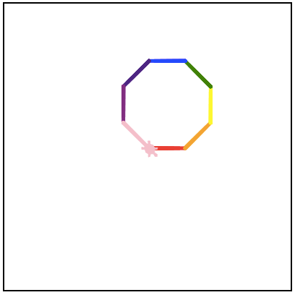
Example #1: Rainbow Octagon
Write a program that has Tracy draw an octagon where each side is a different color.
Notes:
In our first example, we are asked to draw an octagon where each side is a different color and the pensize is 10 pixels thick.

Slide 10

Example #2: Circle Square Triangle
Write a program that has Tracy use the advanced circle parameters to draw a circle, square, and triangle filled in with different colors.
Notes:
In our second example, we need to draw a circle, triangle, and square from the same starting point. They all need to be filled in with different colors.

Slide 11
Commands Learned this Lesson
Command | What does it do?
color(“color_name”) | Changes Tracy’s trail color
pensize(90) | Changes Tracy’s trail thickness
begin_fill() | Starts filling in drawn shapes
end_fill() | Stops filling in drawn shapes
circle(radius, extent,steps) | Can control the radius, degree, and number of points of a circle
Notes:
In this lesson, we learned a bunch of new commands that will allow us to draw more creative images with Tracy. Use these commands and those you have already learned to complete the next set of Tracy exercises!

